Slide 1
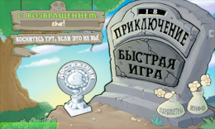
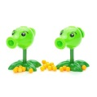
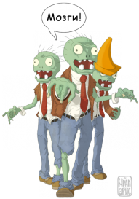
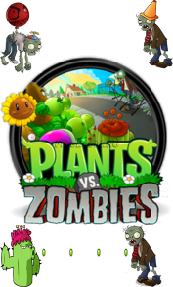
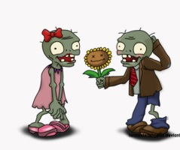
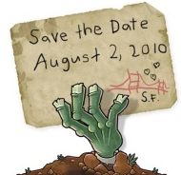
Crazy Town RIA – Guide
Level 1.
“Battle notification”
Notification Preparation & Publication on the Official Website
PUBLIC CONSULTATIONS
on Act Preparation Notification
Summary of the Survivors Proposals
TOMB & DRAFTS DEVELOPER
Draft Act Preparation
Level 2.
“Draft Act
&
IA Report”
Draft Act & IA Report Final Cooking
PUBLIC CONSULTATIONS
оn draft text
IA Report Preparation
Chopped Draft Act - Final
Chopped IA Report - Final
PUBLIC CONSULTATIONS
Final Summary of the Survivors Proposals
EMPOWERED BODY
More! – More!
CONSULTATIONS
ZORV Preparation
AfterZORVing
Level 3.
“Final ZORV Battle”
Notes:
1

